Slide 1
Interactive Visual
Data Analysis
11 – Data navigation and interactive lenses

Slide 2
Objectives
How can we navigate data beyond zooming: Learn additional data navigation techniques
How can we adapt visualizations dynamically: Learn about visualization adjustment via interactive lenses

Slide 3
Overview
Last lecture:
Basic techniques
Today:
Additional data navigation techniques
  Beyond zooming in two dimensions
  Multi-scale input for precise navigation
Visualization adjustment
  Interactive lenses

Slide 4
Beyond zooming in two dimensions
So far, we considered zooming as a means to support the navigation of data shown as a 2D visual representation
Yet, zooming is a general concept applicable beyond just 2D
We look at two examples
  1D zooming for univariate temporal data
  nD zooming for multivariate (temporal) data

Slide 5
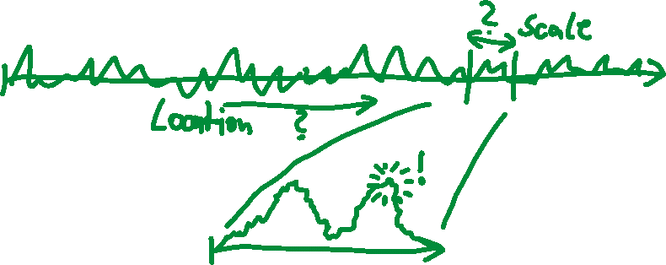
Beyond zooming in two dimensions
General case of zooming
Where (location) and how much (scale) of a data variable should be studied to find interesting patterns?
Find answer via interactive zooming!

Slide 6
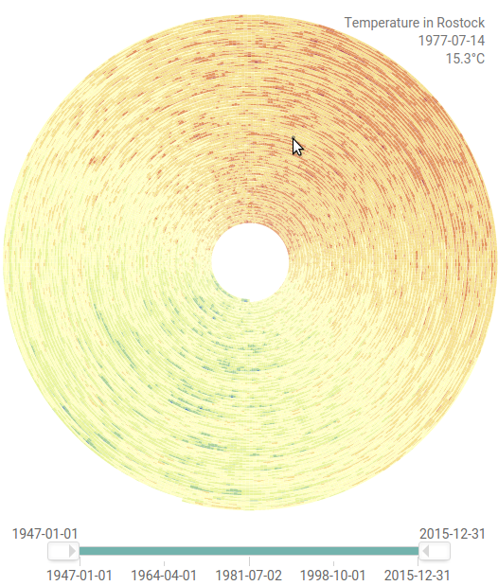
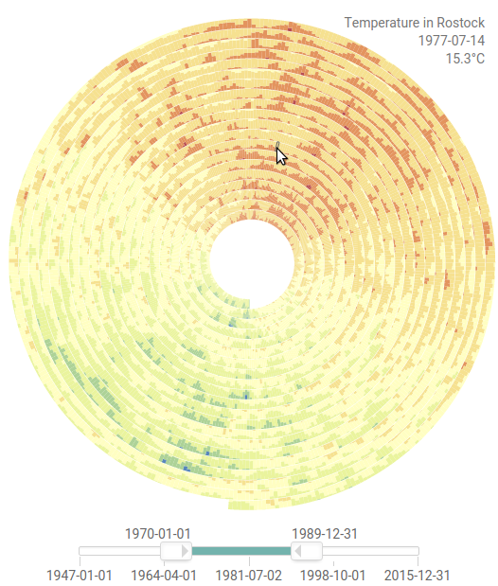
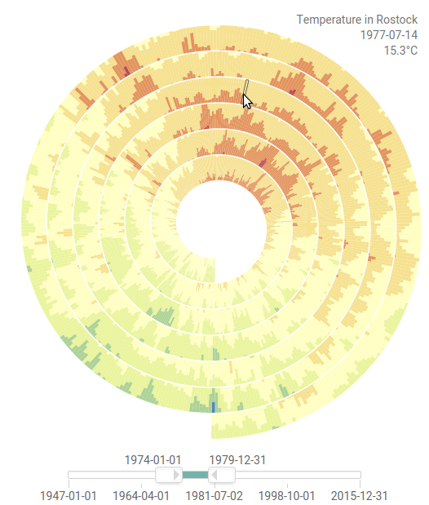
Beyond zooming in two dimensions
Example: 1D zooming for univariate temporal data
Explore temperature data on a spiral display
Interactive range slider for zooming and panning along the 1D time axis
Temporal data visualization was the topic of Lecture 6.
https://vcg.informatik.uni-rostock.de/~ct/software/EnhancedSpiral.js/index.html

Slide 7
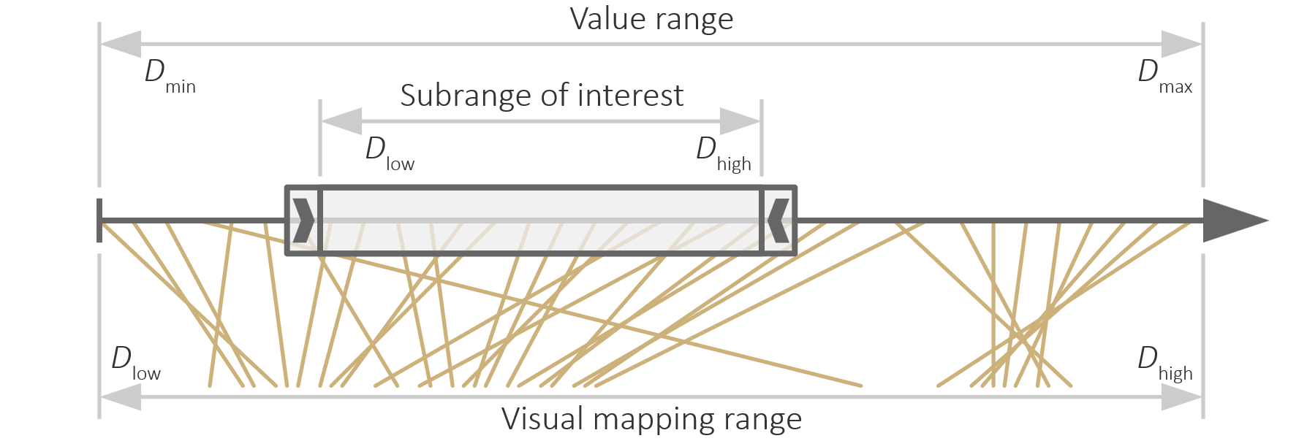
Beyond zooming in two dimensions
General case of nD zooming for multivariate data
Question: How to zoom nD data?
Answer: Combine multiple 1D zoomable axes
Think about: What about interaction costs, physical and mental?
Notes:
Physical costs:
Handles must be discovered
Handles might be difficult to pick due to small size
Handles must be positioned precisely to define location and scale exactly
Mental costs:
Axes shows value range (for slider) and visual mapping range (for data) at the same time
Users must understand this dual-use of the axis

Slide 8
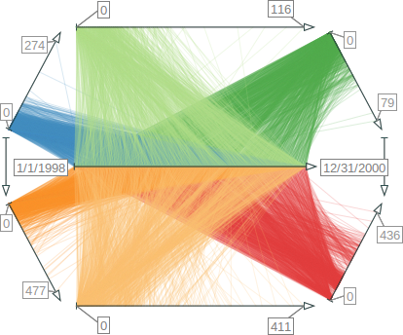
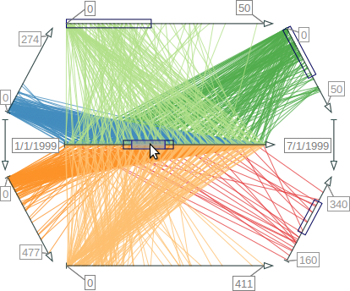
Beyond zooming in two dimensions
Example: nD zooming for the TimeWheel
Central axis for time, radial axes for time-dependent variables
Each axis can be zoomed independently or in a linked-fashion → nD zoom

Slide 9
Multi-scale input for precise navigation
Problem: When navigating larger value ranges, we may have insufficient interaction precision due to too-low pixel resolution
Example:
  Time series with 25.000 days would require 25.000 pixels for sufficient precision
  Realistically, if we assume a slider with 1.000 pixels (i.e., 25.000 days are mapped to 1.000 pixels), each pixel corresponds to 25 days.
  Drag interaction by 1 pixel would navigate by 25 days, essentially skipping 24 days
  There is no way to access the skipped days 😒
Think about: How to navigate precisely when resolution is limited?
Solution: Interaction not only on single scale, but on two or more scales

Slide 10
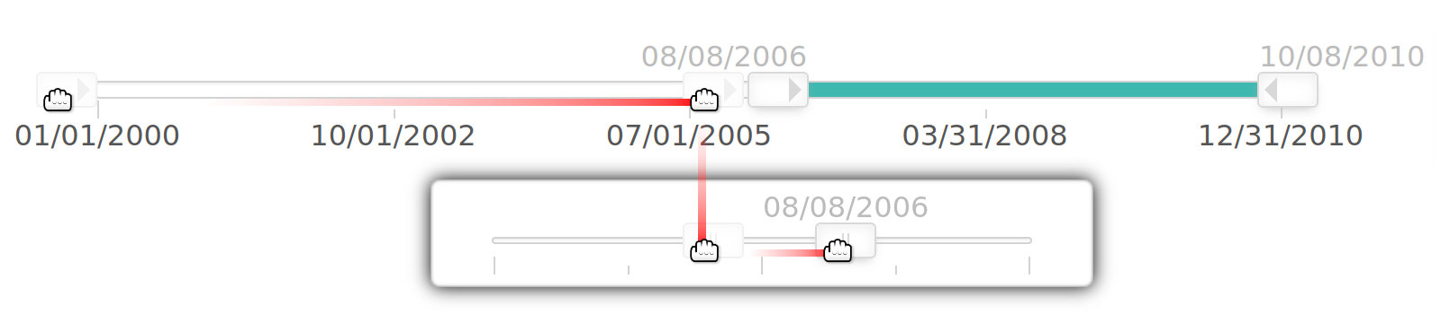
Multi-scale input for precise navigation
Dual-scale slider
Regular slider for coarse and fast navigation
On-demand high-precision slider for fine but slow navigation
Regular two-handle range slider covering the entire value range
Dynamic on-demand slider for navigating a subset (hence higher precision) of the value range

Slide 11
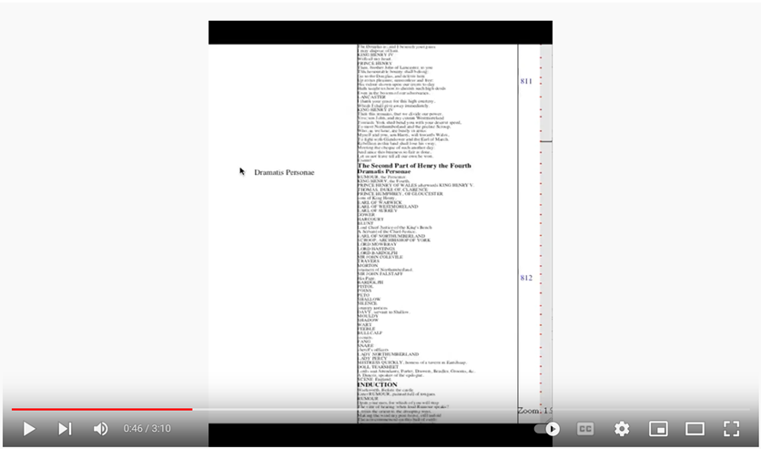

Multi-scale input for precise navigation
Multi-scale navigation with OrthoZoom
Zooming via drag operation
Drag semantics depend
on direction
  Vertical direction determines
  location in the data (where)
  Horizontal direction determines
  how much data (scale)
https://www.youtube.com/watch?v=fwz04BNRQQQ

Slide 12
Overview
Last lecture:
Basic techniques
Today:
Additional data navigation techniques
  Beyond zooming in two dimensions
  Multi-scale input for precise navigation
Visualization adjustment
  Interactive lenses

Slide 13
Motivation
We learned about interaction intents in Lecture 9.
Interaction intents (Yi et al., 2007)
So far
Fundamental picking, interactive selection, and accentuation
  Mark something as interesting
  Show me something conditionally
Navigating zoomable visualizations
  Show me something else
  Show me more or less detail

Slide 14
Motivation
Interaction intents (Yi et al., 2007)
Now
Interactive lenses
  Show me a different arrangement
  Show me a different representation

Slide 15
Motivation
Standard interaction
  Performed using graphical user interface
  Leads to global and permanent change of visual representation
Implications
  Action and response spatially separated → Effect can be difficult to comprehend
  (What did just happen?)
  Global effect → Context can be difficult to maintain
  (How did it look like before?)
  Permanent effect → Difficult to return to previous view
  (How can I undo the change?)
Elegant alternative: Interactive lenses

Slide 16
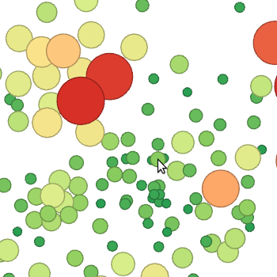
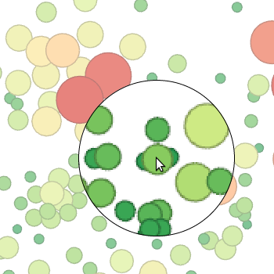
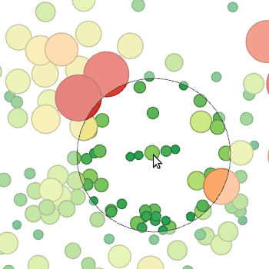
Interactive Lenses
A first example: Access details in visual representations
Regular visualization
Simple magnification
Fisheye distortion

Slide 17
Interactive Lenses
Next, we look at
Definition
Conceptual model
Adjustable properties

Slide 18
Interactive Lenses
Definition
Lens techniques were originally introduced by Bier et al. (1993) under the label Magic Lenses.
“
An interactive lens is a lightweight tool to solve
a localized visualization problem by temporarily altering a
selected part of the visual representation of the data.
— Tominski et al., 2017
“
Lenses are lightweight exploration tools that can be added to a visualization on demand. […] A key characteristic is that lenses produce local and transient changes in the visualization. That is, the visual representation is adjusted only in selected parts and its original state is restored once the lens is dismissed.
— Tominski & Schumann, 2020

Slide 19
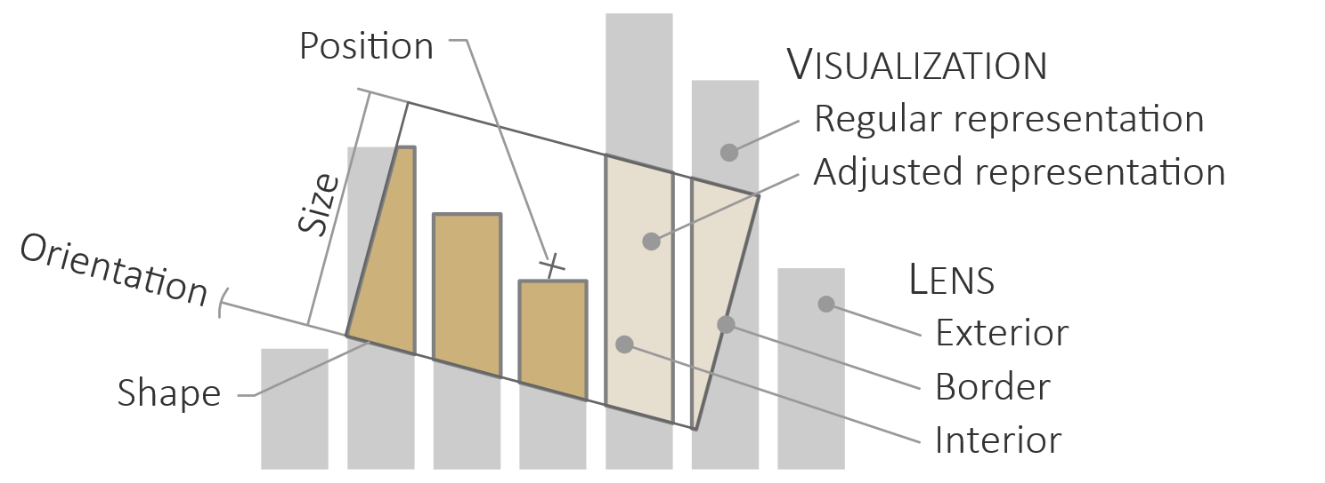
Interactive Lenses
Conceptual model

Slide 20
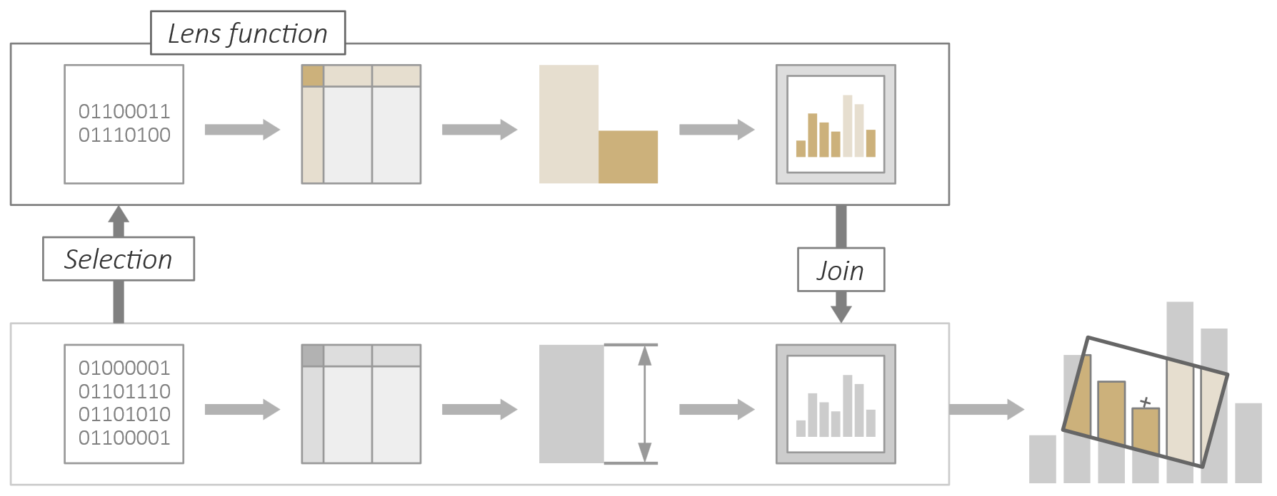
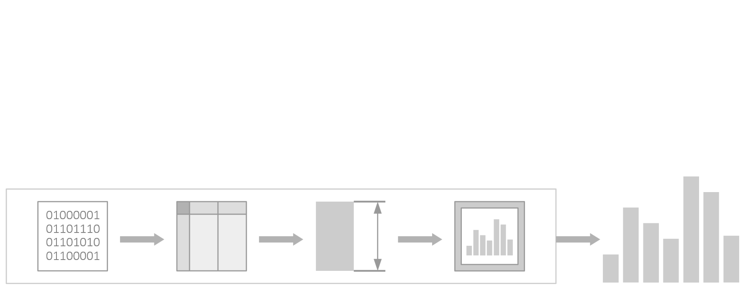
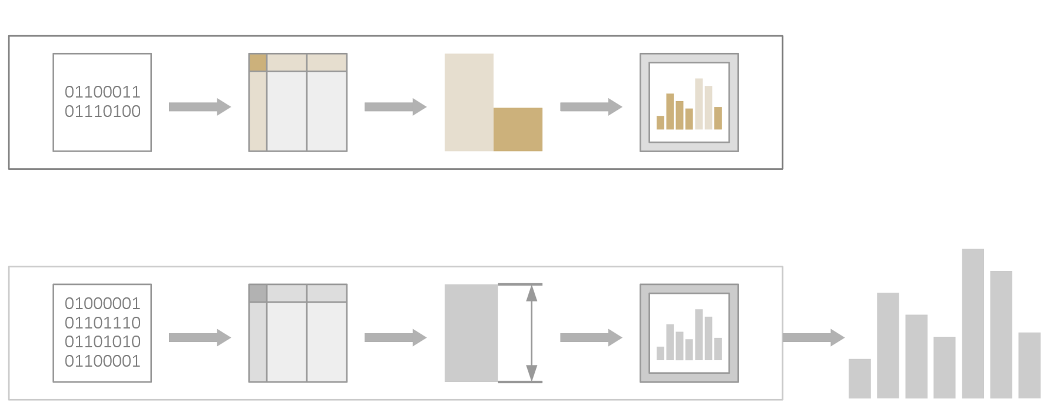
Interactive Lenses
Conceptual model
  Interactive lenses can be modeled as additional visualization pipeline attached to the regular visualization pipeline
Attached visualization pipeline (lens)
Regular visualization pipeline

Slide 21
Interactive Lenses
Conceptual model
Lens techniques consist of three main ingredients
Input data: Selection determines what data are to be affected by the lens
Data processing: Lens function defines how the visual representation of the selected data looks like
Result output: Join merges the changed visual representation with the base visualization

Slide 22

Interactive Lenses
Selection: What is to be affected
  Key to the “local” nature of the interaction:
  Selection → smaller data subset → local effect
  Defines part of the visual representation to be changed
  Typically corresponds to content under lens
  Selected content can be from any stage of the visualization pipeline
  (pixels, geometry, or underlying data)
  Based on selected content, the lens function computes a lens effect

Slide 23

Interactive Lenses
Lens function: How is the visual representation changed
  Processes selected content to generate lens effect
  Depending on stage where selection took place, only particular processing steps needed
  Selection usually much smaller than entire dataset: Advanced and potentially costly operations possible on reduced subset
  Large variety of lens function in literature
  → Three basic lens effects

Slide 24
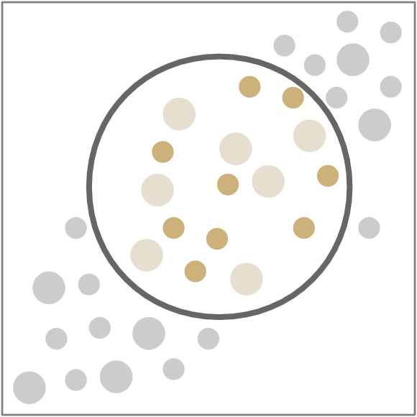
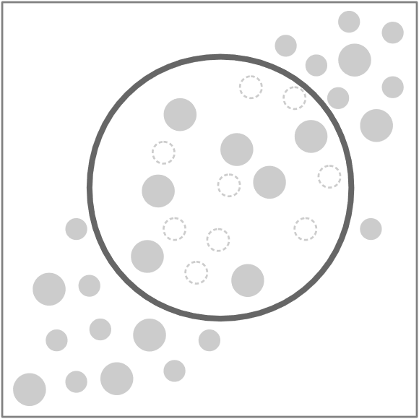
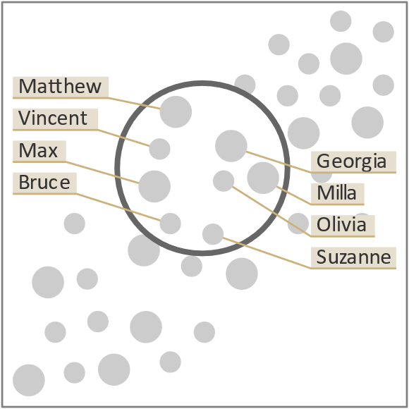
Interactive Lenses
Lens effects: What types of changes are possible
  Alteration: Change existing content
  Suppression: Remove existing content
  Enrichment: Add new content
Alter: Change color
Suppress: Filter dots
Enrich: Add labels

Slide 25
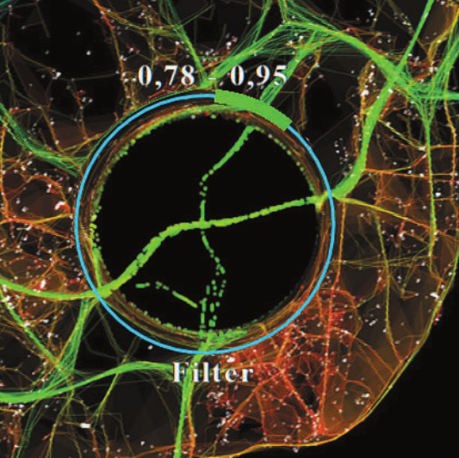


Interactive Lenses
Join: How to bring lens and visualization together
  Join lens effect with regular visualization
  Possible at stages of pixels, geometry, or underlying data
  Additional visuals: UI, lens circle, dim background
Relevant data items maintain their position, filtered data items are shifted to the lens border. Join takes place on the geometry stage.
Lens function parameters
Lens function name
Lens ring
Hurter et al. (2011)

Slide 26
Interactive Lenses
Next, we look at
Definition
Conceptual model
Adjustable properties

Slide 27
Interactive Lenses
Properties
Spatial selection → Geometry
  Position & size, shape, orientation
Lens function → Parameters
  Depend on function
  Example: Magnification factor, sampling rate, …

Slide 28
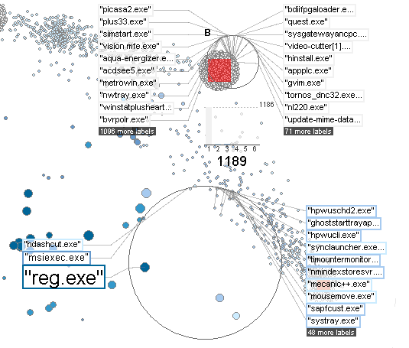
Interactive Lenses
MoleView,
Hurter et al. (2011)
(interactive size)
Extended Excentric Labeling,
Bertini et al. (2009)
(automatic size)
Position & Size
Usually interactive via natural drag gestures
May also be set automatically
Automatic table lens,
Tominski (2011)
(automatic position)

Slide 29
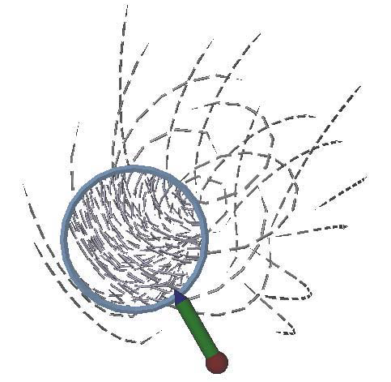
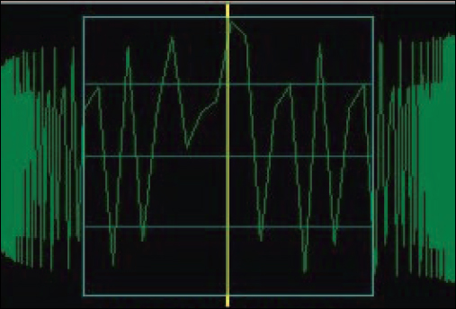
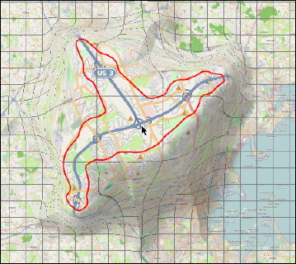
Interactive Lenses
Lens for Flow Vis.,
Fuhrmann & Gröller (1998)
(circular)
Shape
Circular
Rectangular
Self-adapting
JellyLens,
Pindat et al. (2012)
(self-adapting)
SignalLens,
Kincaid (2010)
(rectangular)

Slide 30
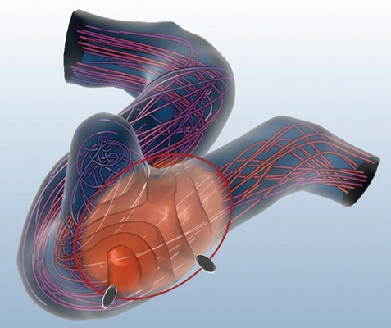
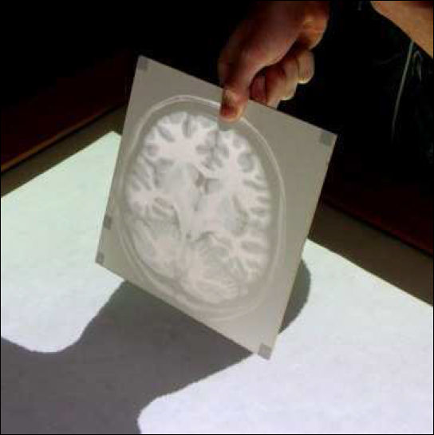
Interactive Lenses
Orientation
Useful for fine-tuning
selection
Opens up new
applications of lenses
FlowLens,
Gasteiger et al. (2011)
PaperLens,
Spindler et al. (2009)

Slide 31
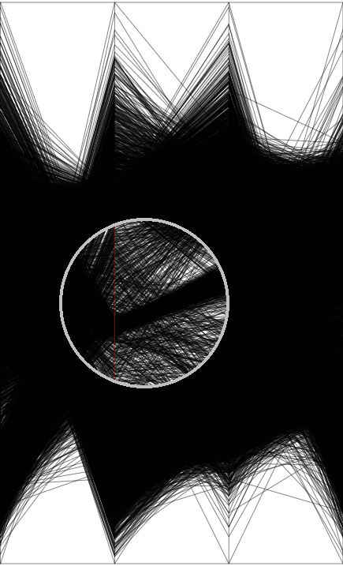
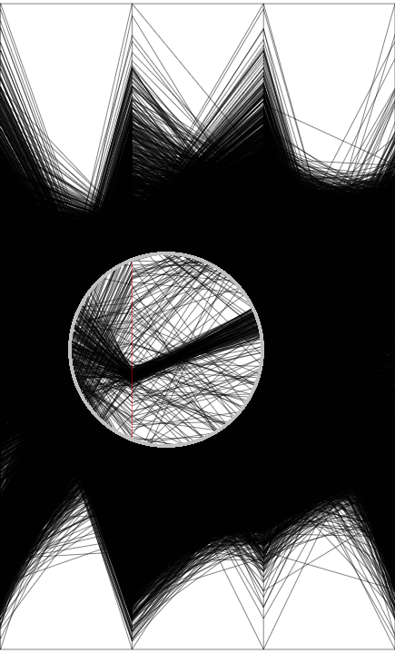
Interactive Lenses
Sampling Lens,
Ellis & Dix (2006)
(sampling rate)
Parameters of lens function
Magnification factor
Sampling rate
…

Slide 32
Interactive Lenses
Interacting with lenses
“
“[…] the fundamental problem is how you provide the user a quick and easy way to: Position the lens, work through the lens, and (possibly) parameterize the lens.
— Maureen Stone, 2014

Slide 33
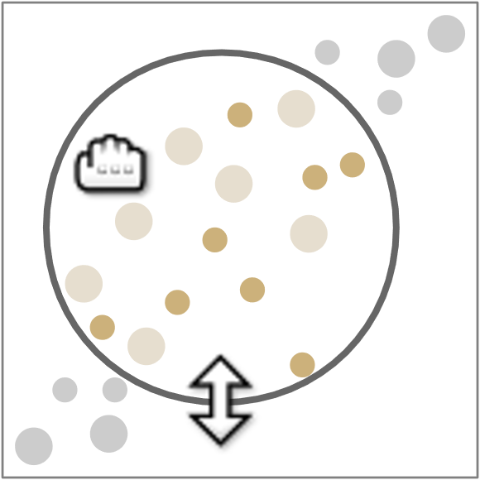
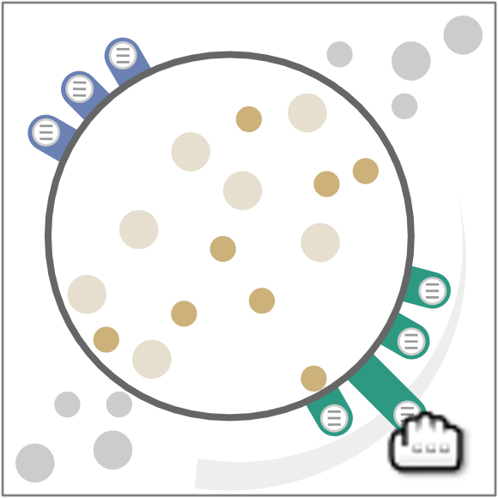
Interactive Lenses
Interacting with lenses
Positioning and resizing via
natural drag gestures
Parameters adjustments
via dedicated on-lens
GUI elements
Think about: How would you interact with data items under a lens?
Notes:
Dragging the lens for positioning it is usually in conflict with any through-the-lens interaction that needs to operate on the underlying data item. Explicit mode switches could resolve the conflict, but such switches imply higher interaction costs. Automatic mode switches are possible, e.g., dwell for some time on a data item to trigger the mode switch. In general, an application-dependent solution needs to be designed.

Slide 34
Interactive Lenses
Lenses in action
Exploring details: Fish-eye lens
Exploring structural relationships: Graph lenses
Exploring temporal aspects of movements: Time lens
Semi-automatic graph editing: Edit lens

Slide 35
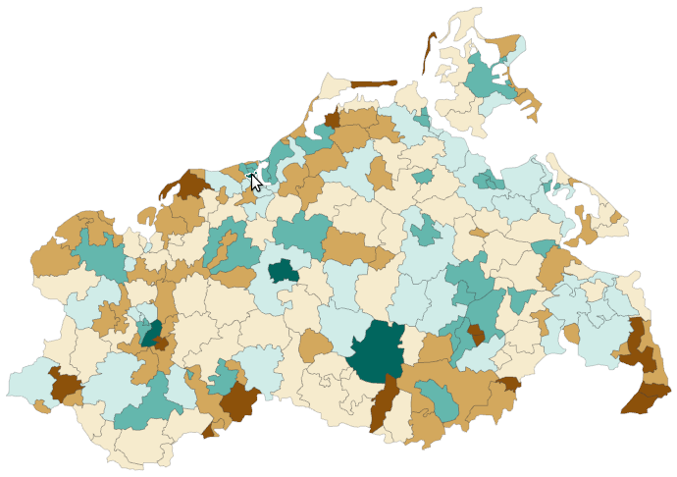
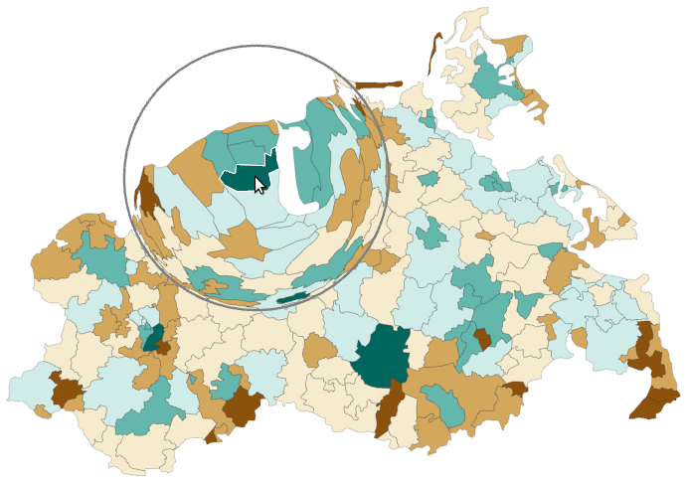
Interactive Lenses
We already talked about fisheye distortion in Lecture 4.
Exploring details: Fish-eye lens
Problem: Identify color under cursor w/o zooming
Fish-eye lens: Local magnification around cursor

Slide 36
Interactive Lenses
Exploring details: Fish-eye lens
Fisheye distortion (Sarkar and Brown, 1994)
  Selection: Points of the geometric description of the geographic regions
  Lens function and effect:
    Processing: Translate points to new position (details on next slide)
    Effect: Magnified geographic regions around the lens center
  Join:
    Override original point positions with new ones
    Superimpose lens ring

Slide 37
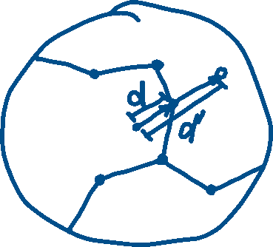
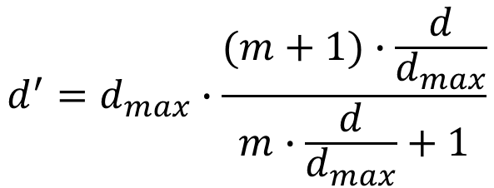
Interactive Lenses
Exploring details: Fish-eye lens
Fisheye distortion (Sarkar and Brown, 1994)
  Select all geometric points with distance to lens center d < d_{max} (the lens radius)
  For each selected point, push it toward the lens boundary via parametric mapping of original distance d to new distance d’ (magnification factor m defines how far points are pushed)
Think about: Is this simple approach really enough to create a correct magnification?
$$d^{′}=d_{max}∙\frac{(m+1)∙\frac{d}{d_{max}}}{m∙\frac{d}{d_{max}}+1}$$
Notes:
No, this simple solution relies on a geometry with sufficiently high resolution.
If resolution is too low, edges of the geometry could pass the lens without being affected by the distortion. Also edges that cross the lens boundary are not treated correctly.
As a possible solution, more points could be inserted in those parts of the geometry that are affected by the lens. This implies additional computational effort.
In general, we need to balance computational costs and the desired (visual or mathematically correct) effect on the visualization.

Slide 38
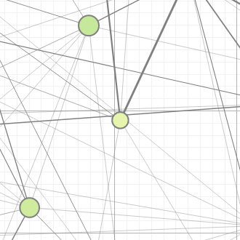
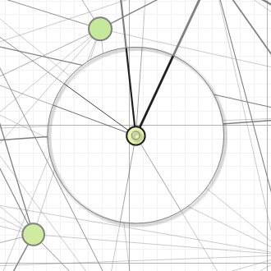
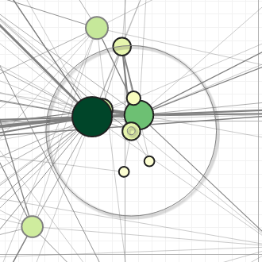
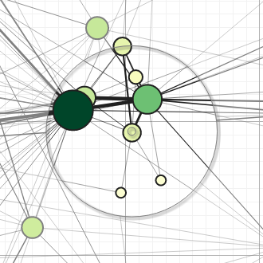
Interactive Lenses
Exploring structural relationships: Graph lenses (Demo)
Problem: view cluttered with edges, neighbors not visible
Local edge lens: Clear view of irrelevant edges
Bring-neighbors lens: Make neighbors visible
Composite lens: Combine lens effects

Slide 39
Interactive Lenses
Exploring structural relationships
Local edge lens:
  Selection: Nodes within the lens
  Lens function and effect:
    Processing: Determine edges incident to selected nodes
    Effect: Suppress all other edges (i.e., edges with no endpoint in lens)
  Join:
    Define clip area (corresponding to lens)
    Clear lens interior
    Draw background grid and selected edges
    Superimpose lens ring

Slide 40
Interactive Lenses
Exploring structural relationships
Bring-neighbors lens:
  Selection: Nodes within the lens
  Lens function and effect:
    Processing: Determine and relocate neighbors of selected nodes
    Effect: All neighbors are within the lens
    Think about: What are reasonable relocation strategies?
  Join:
    Override original node positions of neighbors
    Superimpose lens ring
The bring-neighbors lens implements the idea of “Bring & Go” as discussed in Lecture 10.
Notes:
Relocation alternatives:
Concentric ring layout
Distance-dependent relocation
Tricky: Smooth relocation without discontinuities as the lens is moved

Slide 41
Interactive Lenses
Exploring structural relationships
Composite lens:
  Combine three different lens effects
    Local edge lens
    Bring-neighbors lens
    Fisheye lens

Slide 42
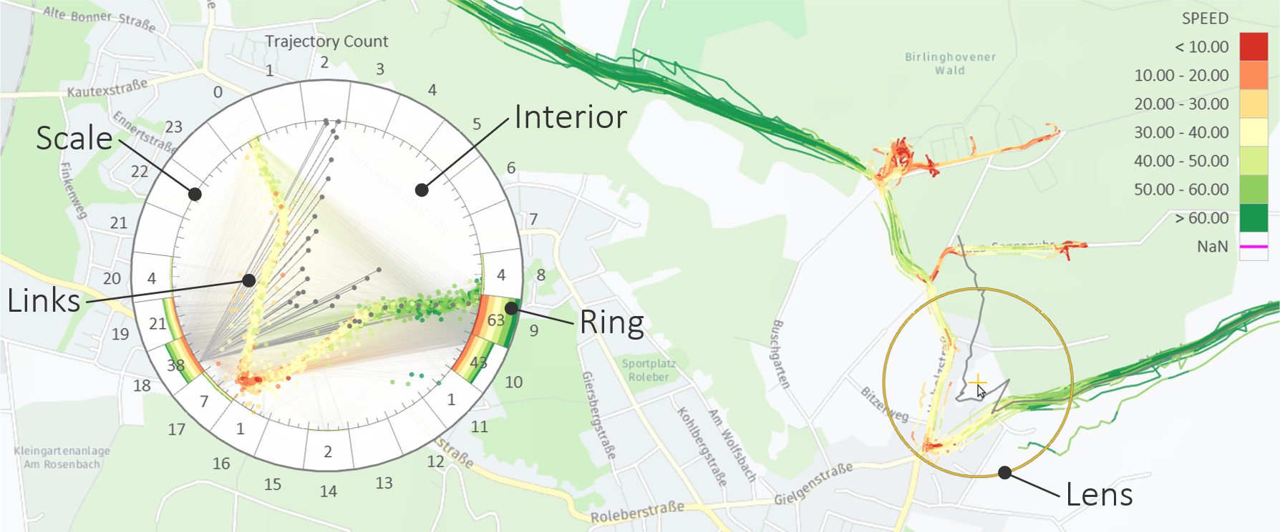
Interactive Lenses
Exploring temporal aspects of movements: Time lens (Demo)
Time lens: Show aggregated temporal information about selected spatial region

Slide 43
Interactive Lenses
Exploring temporal aspects of movements
Time lens
  Selection: Trajectory points in lens
  Lens function and effect:
    Processing: Compute aggregated temporal information
    for selected trajectory points
    Effect: Auxiliary display
  Join:
    Embed auxiliary display
      Radial time histogram in ring
      Selected nodes + time links in interior
    Superimpose lens
With the dedicated display, the time lens is an example of an edge case of lens techniques.

Slide 44
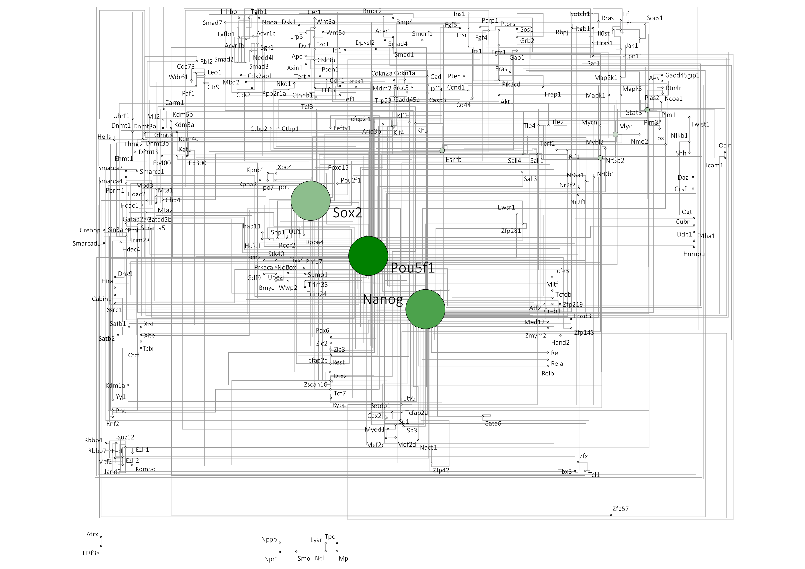
Interactive Lenses
Semi-automatic graph editing: Edit lens
Background:
  Large biological network manually
  curated based on scientific publications
  New publications → Network changes
Challenge: How to locally adapt an
already complex network while
maintaining the overall layout to
preserve the users’ mental map?
Answer: Local semi-automatic adaptations with the EditLens

Slide 45
Interactive Lenses
Semi-automatic graph editing: Edit lens
Two step procedure
  Interactive: Coarsely position the edit lens to define
  region where edit should take effect
  Automatic: Compute locally-optimal layout wrt. lens region
Advantages
  Human expertise can be used to maintain overall layout
  and existing layout conventions
  Computer takes over optimization, which would be too
  costly to carry out for human users

Slide 46
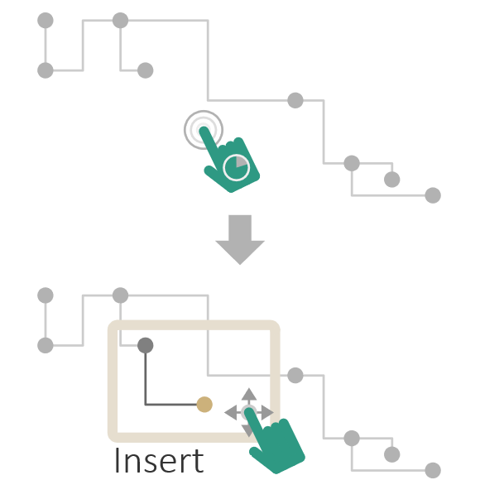
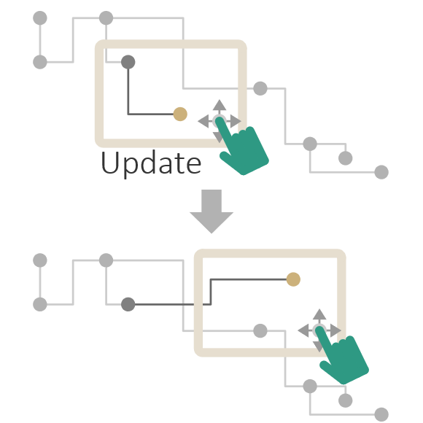
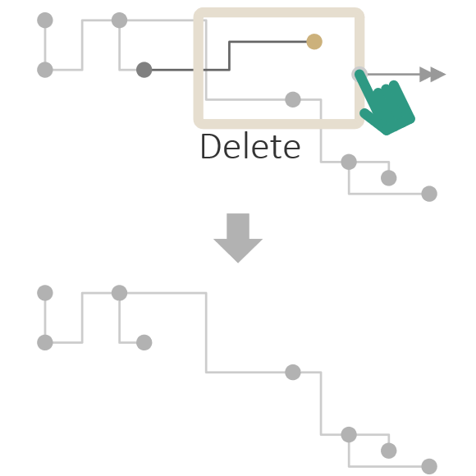
Interactive Lenses
Semi-automatic graph editing: Edit lens

Slide 47
Interactive Lenses
Summary
Lightweight, local, and transient adjustments of visualization
Conceptual components: selection, lens function and lens effect, join
Adjustable properties: Position, size, shape, orientation, parameters
Interaction: Direct + dedicated GUI
Lenses in action: Fish-eye lens, graph lenses, time lens, and edit lens

Slide 48
Assignments
Read “Interactive Lenses for Visualization: An Extended Survey” by Tominski et al. for more conceptual background and more examples of interactive lenses!

Slide 49
Questions
Explain the mapping of data to zoomable axes!
What is multi-scale input and how does it help with data navigation?
How are interactive lens techniques defined, what are their key characteristics in terms of interaction and visual feedback?
Sketch the conceptual model of interactive lenses and explain how selection, lens function, and join operate?
What three fundamental lens effects are possible?
What properties do lenses have and how can they be adjusted?
What is a fish-eye lens? Explain its lens function and effect!
What is the key idea behind the bring neighbors lens?

